Slide 1

Online Shop Creator
Zero Touch Full-stack in a Few Clicks
Team: 27
Qingyi Wang, Xinze Zhou, and Siying Jin

Slide 2
What is Our Project?
Purpose
Help small business owners and retailers to launch their business website online.
Our Solution
An end-to-end website builder and order management system.

Slide 3
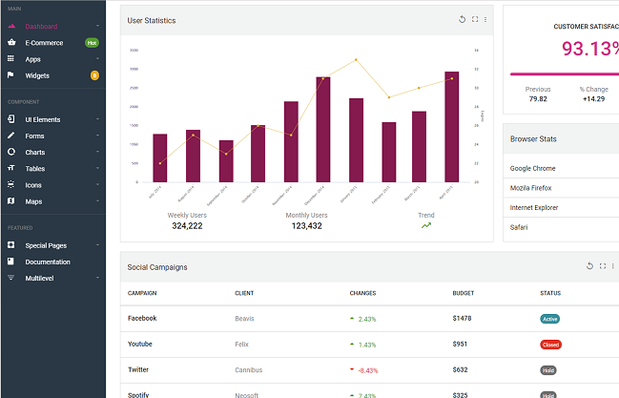
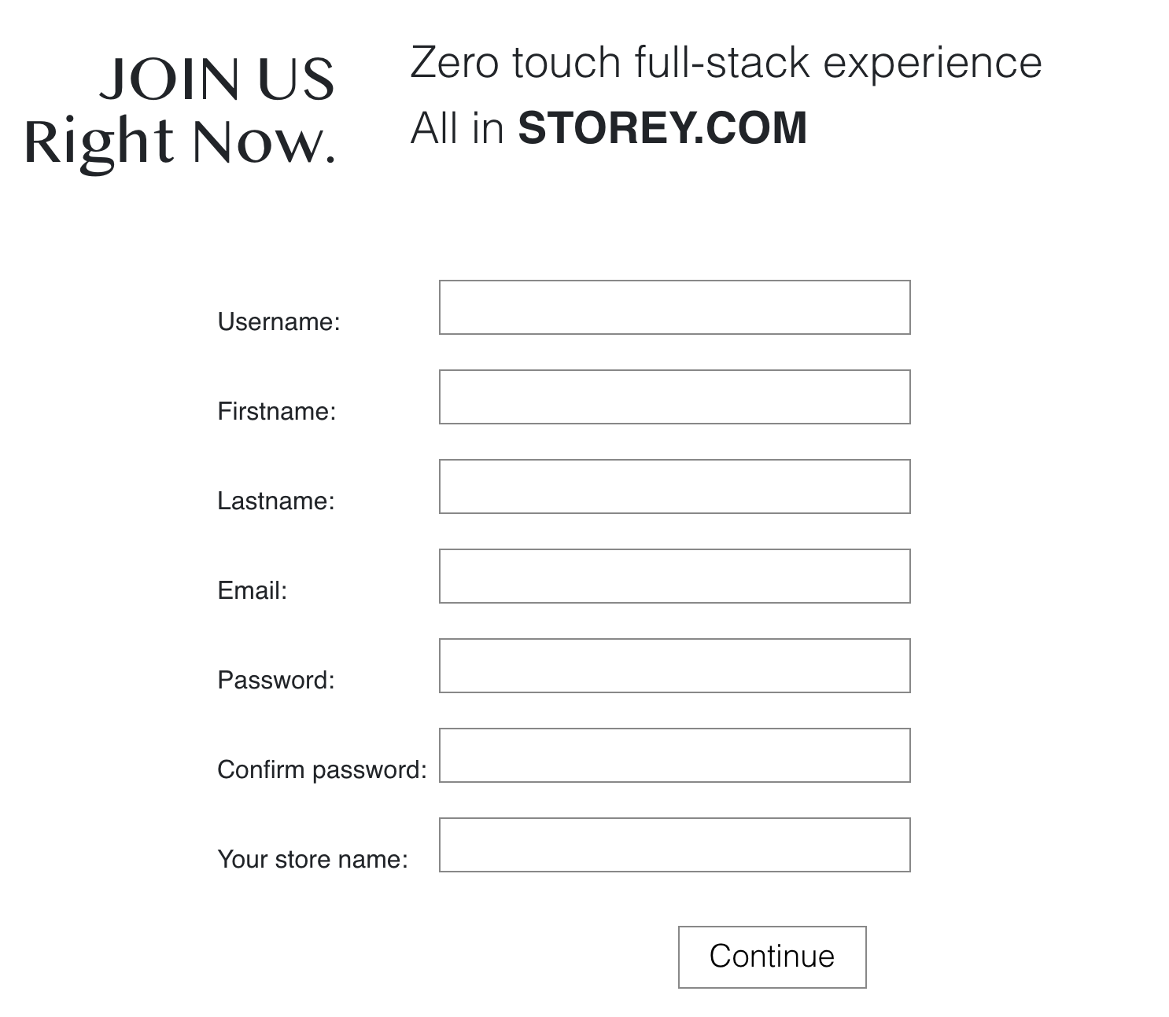
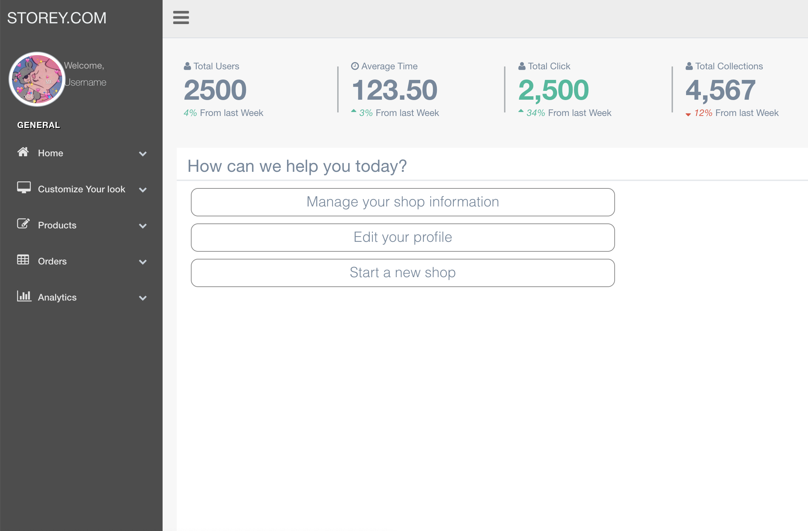
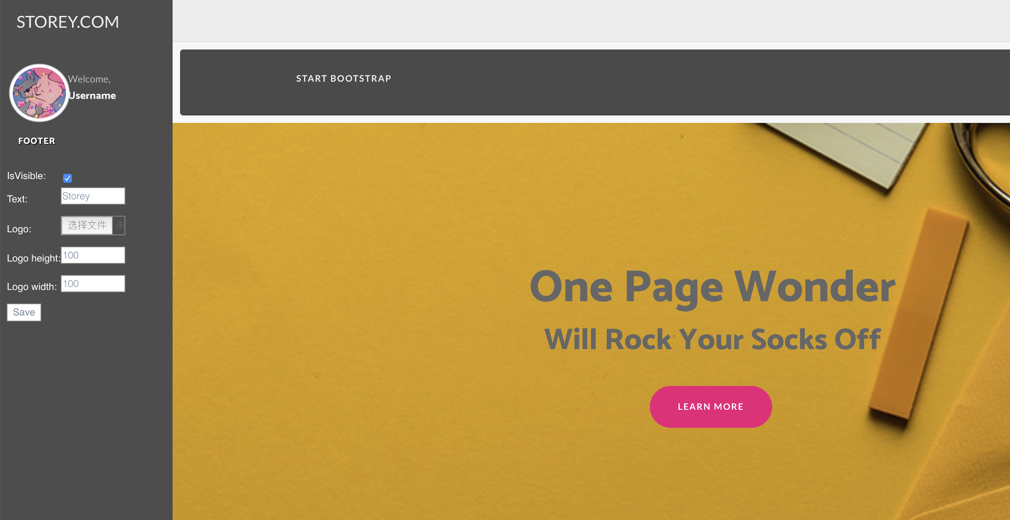
Design Overview
Order Management & Visualization
Sign in/Sign up
User Portal
Shop Website Generator

Slide 4
Features
Automated Shop Website Builder
Website templates
Theme section customization
Domain name provisioning
Order management
View/edit orders and customers
Order statistics visualization

Slide 5
Features
Website product display
Top product recommendation
Similar product recommendation
Filters (out of stock? /collection)
Sort by price/relevance
External data input
Excel/CSV file
CRM platform(Salesforce)

Slide 6
Technologies
Languages: Python, HTML, CSS, Javascript
Framework: Django
Libraries: Bootstrap, jQuery
APIs: Salesforce API

Slide 7

Demo

Slide 8
Project Management
In Sprint 1, we completed:
User authentication; User portal; Website template with homepage;
For Sprint 2, we plan to:
Extend website template to all other pages; Display products in online shop; Edit product information and Add product; Implement filters and product recommendation
Problem we meet

Slide 9
Q & A ?

